Slide 2
FPC Annual General Meeting & Shareholder Information Session
MR MICHAEL GALLAGHER – CHAIRMAN
Introductory remarks
AGM Open
Formal business
Resolutions
AGM Close
Shareholder information session – Mr Angus Geddes

Slide 3
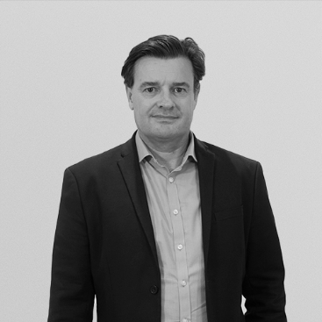
Board Of FPC
INDEPENDENT CHAIRMAN
Michael Gallagher
Mr Michael Gallagher was appointed Chairman of the Board in November 2016. Michael has over 30 years investment experience.
INDEPENDENT DIRECTOR
Katrina Vanstone
Katrina has worked in financial markets for 30 years, both in Australia and offshore, including such leading organisations as HSBC and Deutsche Bank.
In 2009 Michael co-founded Kima Capital, an Australian based funds management business, which he later moved to Hong Kong before it was acquired. Prior to AIMA & Kima, Michael headed Australasian Equities for Rand Merchant Bank, overseeing the Equity Trading, Derivative and Equity Funds Management businesses from 2005-2009. In the 10 years prior to this Michael was a director at Macquarie Bank heading up the structured retail equity derivative businesses in Australia, South Africa and also spent time with Macquarie in the UK.
Katrina has extensive experience in foreign exchange, interest rates and credit markets across asset and liability portfolios. She has held roles in trading, sales and syndication. She has extensive experience in the wholesale debt and derivative markets with strong product knowledge across capital structures and debt raisings, risk management and hedging, and cash and currency management.
Non-Independent Director
Angus Geddes

Slide 4
Resolution 1: Adoption of Remuneration Report for the Year Ended 30 June, 2023
To Consider and, if thought fit, pass the following advisory resolution:
That the Remuneration Report for the year ended 30 June, 2023 (as set out in the Directors’ Report) be adopted.
Resolution | For | Against | Abstain | Open-Usable
Remuneration Report | 2,454,843 | 451,239 | 12,681 | 104,995
 | 81.52% | 14.99% | N/A | 3.49%

Slide 5
Resolution 2: Re-election of Director – Mr Michael Gallagher
To consider and, if thought fit, pass the following as an ordinary resolution:
That Mr Michael Gallagher retires by rotation in accordance with ASX Listing Rule 14.5 and, being eligible for re-election, be re-elected as a Director of the Company.
Resolution | For | Against | Abstain | Open-Usable
Re-election of Mr Michael Gallagher | 5,542,417 | 281,380 | 23,365 | 104,995
 | 93.48% | 4.75% | N/A | 1.77%

Slide 6
Poll Vote for Resolutions 1&2 being counted

Slide 7
AGM CLOSED
Notes:
1. Not going to tolerate the discount any more
2. We are committed as the manager to closing the gap with the board

Slide 8
Manager Report
Shareholder Information Session
Chief Investment Officer
Angus Geddes
Fat Prophets

Slide 9
2023 was difficult to predict
US avoided a recession
Bonds lost the most in history as interest rates rose
US stocks defied gravity, and surged for most of the year, but rally confined to the “magnificent 7”
RoW outside the US has not performed as well – MSCI World Index and ASX200 are at the same levels as this time last year
Sticky inflation, firmer oil prices, and rising geopolitical

Slide 10
FPC NTA 2021 to 2023
 | Pre-Tax NTA | Post-Tax NTA
Sept – 2021 | $1.3623 | $1.2994
Sept – 2022 | $0.9491 | $1.0146
Sept- 2023 | $1.0386
Notes:
We played it safe in Japanese banks
Missed reducing portfolio risk in May by one month which effected our results
Fund has been stable since June/July – lower volatility than the broader market

Slide 11
Playbook for the coming year
2024 outlook
Rising geopolitical tensions
US dollar to reassert on the downside
Bond yields to find a ceiling
Japanese equities to continue outperforming
Oil prices to hit $100+ on supply constraints
Gold to hit new record highs
Uranium the next big trend in energy
Energy stocks offer growth and defensive earnings
Opportunities in China / Hong Kong

Slide 12
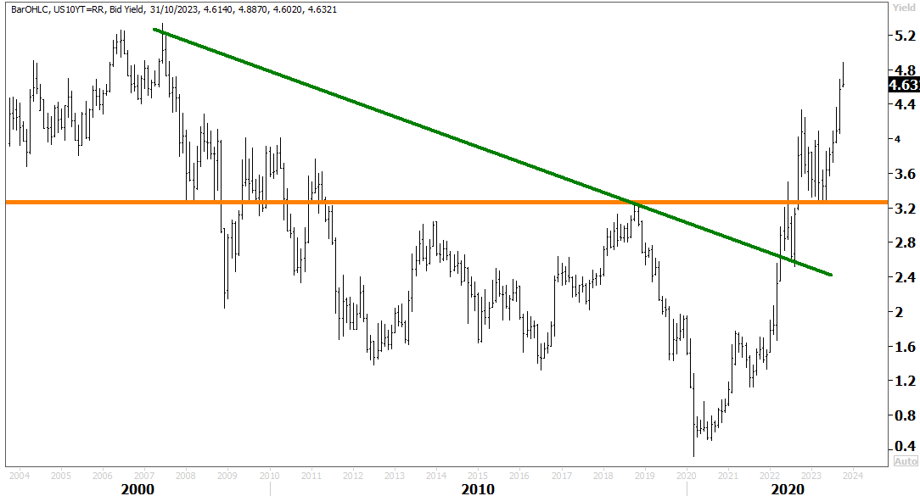
US 10-year government bond yields likely peaking near term
Notes:
This year has been all about tightening US financial conditions in response to inflation – Fed raising rates and withdrawing liquidity
2022 was also the year of King Dollar which has appreciated into those tighter conditions
A growing consensus believe this to be the end of the bear market, with a Fed pause in sight – this is true, and the US may yet skirt a recession of have a soft landing, but the bear market has one last piece of unfinished business yet

Slide 13
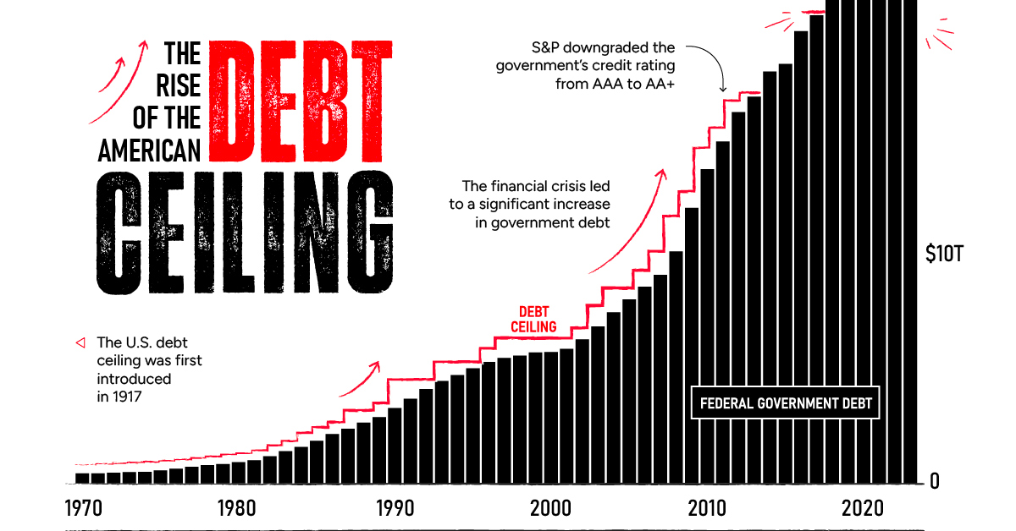
Longer term US fiscal situation is deteriorating Secular bear market in bonds has further to go
Notes:
Downward earnings revisions could come through sharply in January and February when S&P500 companies report December quarterly earnings
Not really reflected in the S&P500 price
Markets have been fixated on the Fed, inflation and interest rates…but soon, earnings will come sharply into focus
Overearning of companies post pandemic will unwind, costs are going to remain elevated, margins will be squeezed (sticky labour costs) and this will cause the final leg lower for US stocks
Good news is I see a bear market low being reached in the first quarter of next year, when downgrades for FY23 are finally reflected in valuations.

Slide 14
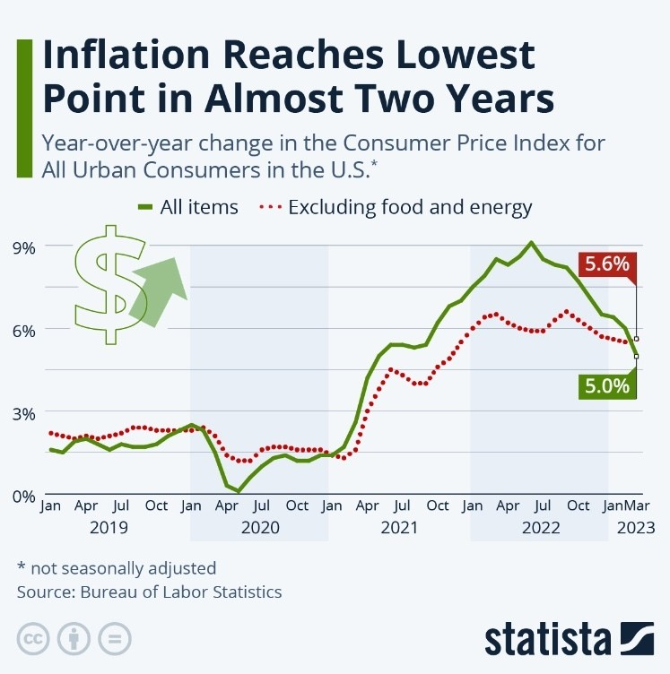
Inflation is likely to prove sticky
Notes:
2023 is going to be traders market, with a strong finish into the end of the year
US market could find a bottom around the 3000/3300 level
We never saw capitulation in the June/October selloffs and tests of the lows
This could be coming early next year – and then a strong rally into the end of the year

Slide 15
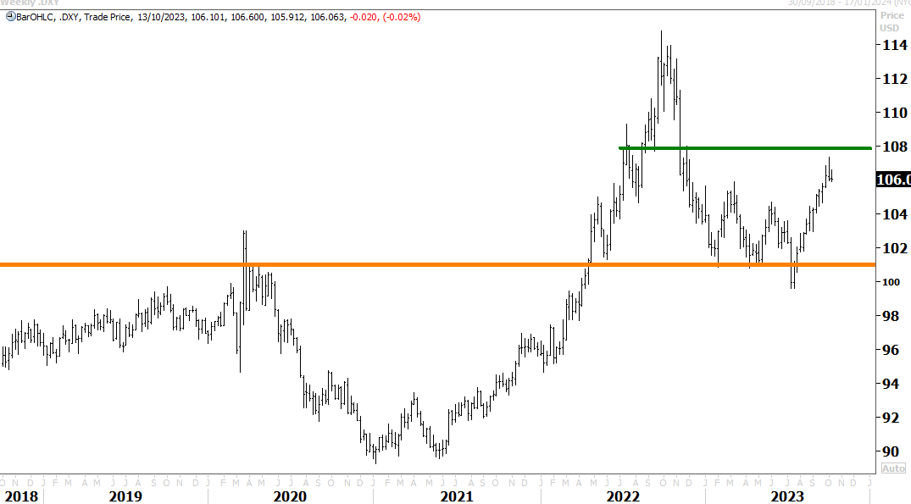
Dollar set to resume downward path in 2024
Notes:
Asian bear market looks to be ending, longest one in history at 660 days
SPX should find strong support at the 3000 breakout level and then recover into the end of the year –
4000 would be achievable if US economy skirts a recession, unemployment doesn’t rise much above 5%, inflation is brought under control and the Fed begins to ease
Excesses wrought by the pandemic and stimulus binge should have washed through the system
Valuations will be cheaper, and economic rebound within sight in 2024

Slide 16
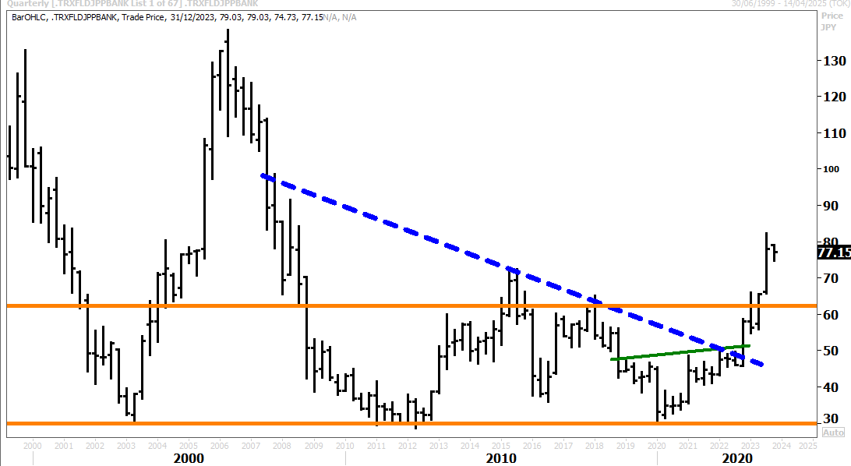
Growth opportunities in Japanese equities and especially the banks Markets not expecting this outcome
Refinitiv Japanese Bank Price Index
Notes:
M2 rapid growth in 2021 told us monster inflation was on the way – which the big story in 2022
but M2 growth has since collapsed – so guarantees inflation will come down…as Milton Friedman said “inflation is everywhere a monetary phenomenon”
Inflation will surprise to the downside – we think, in line with consensus, inflation will come down to 4-5% faster than expected (consensus estimates 5-6%) – because of M2 supply decline
Bond yields will fall sharply, the dollar will weaken – triggering a powerful rally in US, global equities, emerging markets, commodities and precious metals in the 2nd half of next year

Slide 17
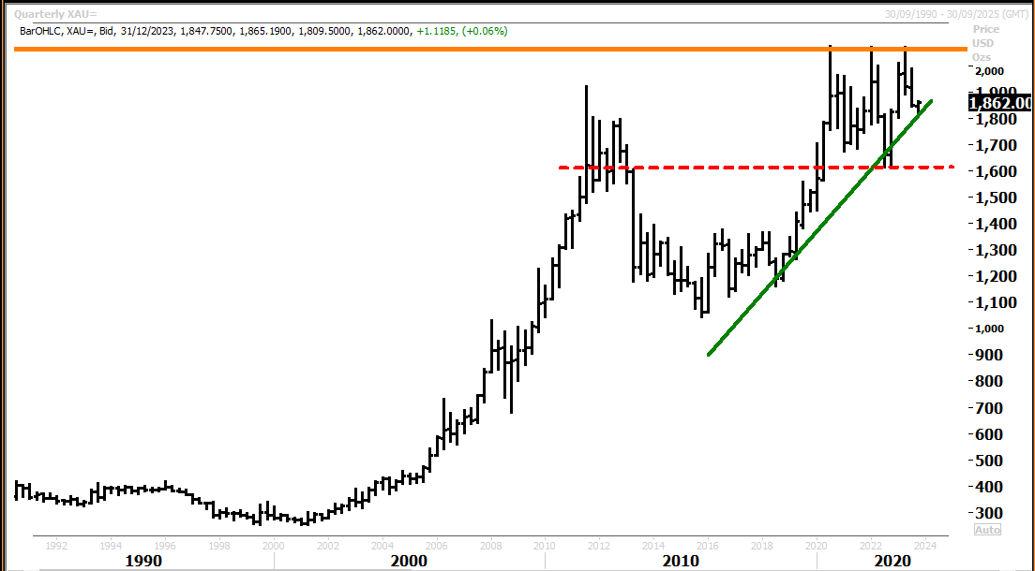
Gold to outperform versus the US dollar amidst rising geopolitical tensions
Notes:
Bonds to outperform as inflation cools and the US economy slows
Bonds underperformed in 2022 – but could do much better next year
We have taken a trading position in US treasuries and US corporate debt as peak inflation and Fed tightening looks now to be fully priced into the market
T Bond yields have risen to much this year and could now overshoot on the downside in 23
Forward inflation expectations have stabilised at about 3%
Rising US unemployment will take pressure off the Fed

Slide 18
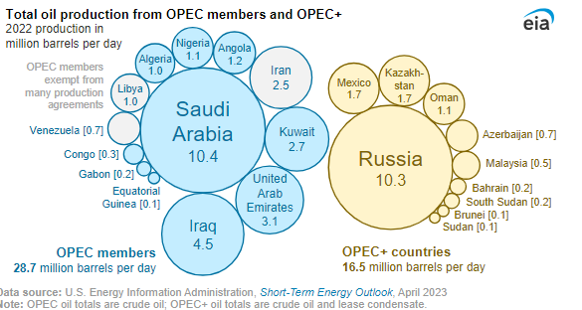
Opportunities in energy + OPEC pricing power is back to 1970s style
Notes:
In recent months gold prices have been performing in-line with rising real rates and a relatively strong US economy.
there are signs now of a potential slow down in tightening from here on in – this could provide support for gold
USD looks to have put in an important top
P/NPV currently sits at ~0.95x vs historical avg of ~1.3x – and is cheap
We like NCM, GOR, EVN, NST

Slide 19
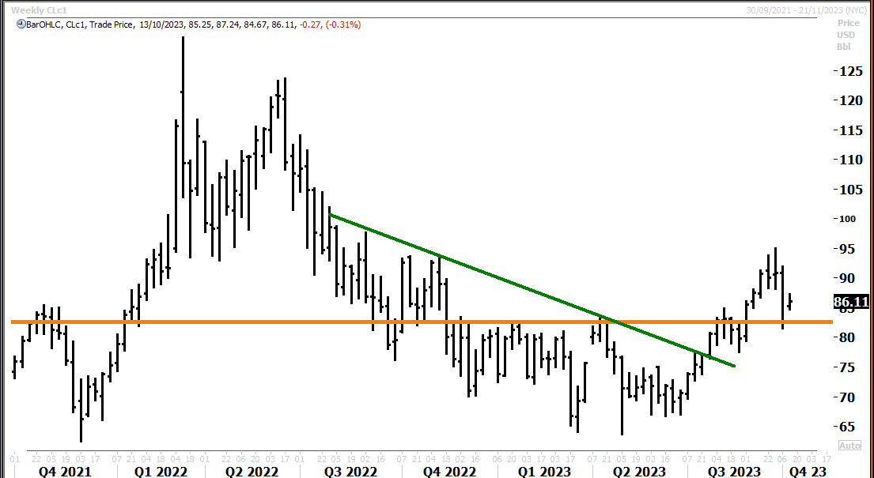
Energy stocks to outperform as oil prices rise back above US$100

Slide 20
Climate change is going to drive up demand for uranium

Slide 21
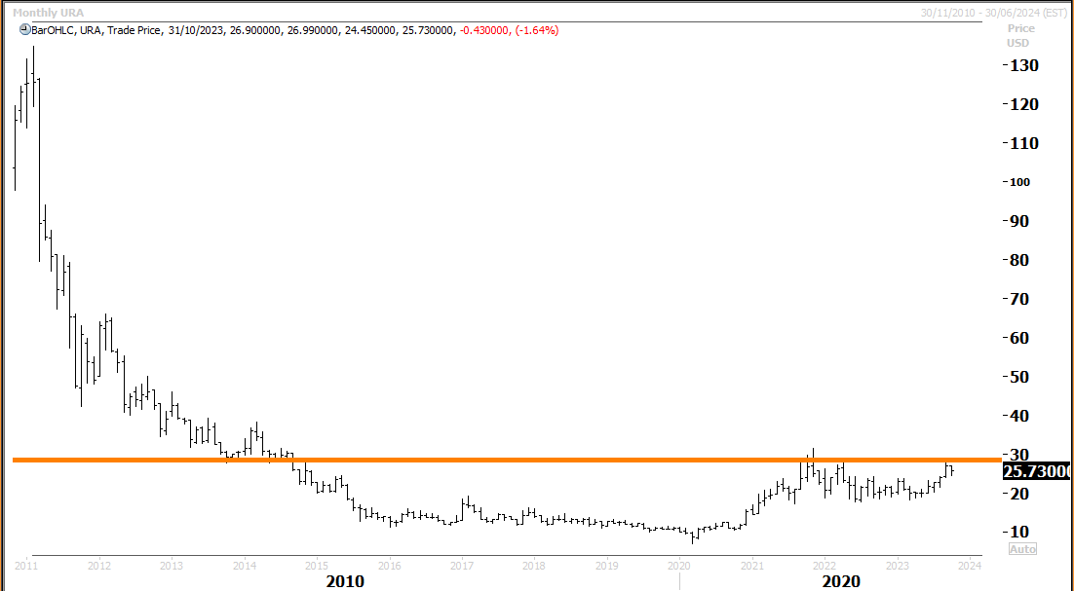
Global uranium miners cheap

Slide 22
Top 10 Holdings in FPC - 2023
Top 10 Holdings | Country | 30 September 2023
Sumitomo Mitsui Financial Group | Japan | 10.13%
Paladin Energy | Australia | 6.71%
Global X Uranium ETF | United States | 5.60%
Resona Holdings Inc | Japan | 5.28%
Evolution Mining Ltd | Australia | 5.05%
Whitehaven Coal Limited | Australia | 4.55%
Mitsubishi EFJ Financial Group | Japan | 4.38%
Mizuho Financial Group | Japan | 4.22%
Chiba Bank Ltd | Japan | 4.16%
Northern Star Resources | Australia | 3.75%

Slide 23
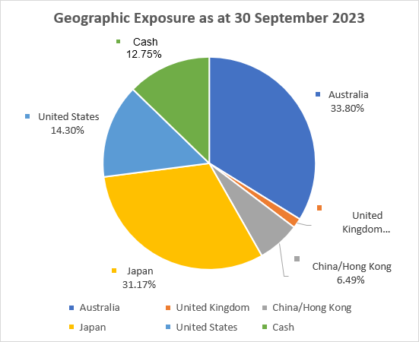
Geographic Exposure – Sept 2023

Slide 24
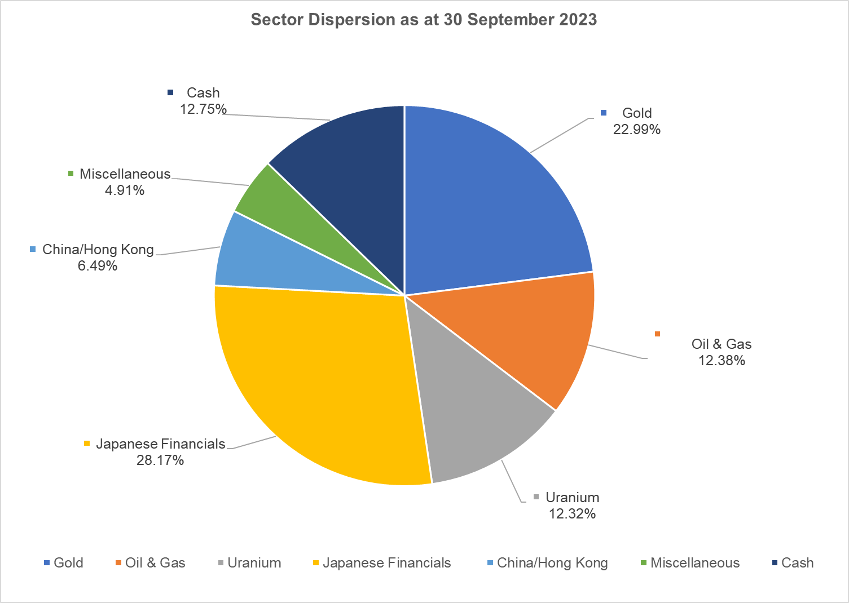
Sector Dispersion – Sept 2023

Slide 25
Contact Details
Fat Prophets Funds Management
Investment manager
Angus Geddes CIO
Angus.Geddes@fatprophets.com.au
Fat Prophets Global Contrarian Fund Company
Michael Gallagher Chairman
Michael@spinnakerinvest.com
Fat Prophets Funds Management
Portfolio Manager Simon Wheatley
Simon.Wheatley@fatprophets.com.au

Slide 26
Disclaimer
This presentation has been prepared by Fat Prophets Global Contrarian Fund Limited (FPC). The information contained in this presentation is for information purposes only and has been prepared for use in conjunction with a verbal presentation and should be read in that context.
The information contained in this presentation is not investment or financial product advice and is not intended to be used as the basis for making an investment decision. Please note that, in providing this presentation, FPC has not considered the objectives, financial position or needs of any particular recipient. FPC strongly suggests that investors consult a financial advisor prior to making an investment decision.
This presentation is strictly confidential and is intended for the exclusive benefit of the institution to which it is presented. It may not be reproduced, disseminated, quoted or referred to, in whole or in part, without the express consent of FPC .
No representation or warranty, express or implied, is made as to the fairness, accuracy, completeness or correctness of the information, opinions and conclusions contained in this presentation. To the maximum extent permitted by law, none of FPC, its related bodies corporate, shareholders or respective directors, officers, employees, agents or advisors, nor any other person accepts any liability, including, without limitation, any liability arising out of fault or negligence for any loss arising from the use of information contained in this presentation.
This presentation includes “forward looking statements”. Such forward-looking statements are not guarantees of future performance and involve known and unknown risks, uncertainties and other factors, many of which are beyond the control of FPC and its officers, employees, agents or associates that may cause actual results to differ materially from those expressed or implied in such statement. Actual results, performance or achievements may vary materially from any projections and forward looking statements and the assumptions on which those statements are based. FPC assumes no obligation to update such information.
This presentation is not, and does not constitute, an offer to sell or the solicitation, invitation or recommendation to purchase any securities and neither this presentation nor anything contained in it forms the basis of any contract or commitment. Any offer or sale of securities will be made pursuant to definitive documentation, which describes the terms of the offer (Offer Document). An Offer Document for any offer of securities in FPC will be made available when the securities are offered. Prospective investors should consider the Offer Document in deciding whether to acquire securities under the offer. Prospective investors who want to acquire under the offer will need to complete an application form that is in or accompanies the Offer Document.
This presentation does not constitute an offer to sell, or a solicitation of an offer to buy, any securities in the United States. The securities of FPC have not been, and will not be, registered under the U.S. Securities Act of 1933, as amended (Securities Act) or the securities laws of any state or other jurisdiction of the United States, and may not be offered or sold in the United States except in compliance with the registration requirements of the Securities Act and any other applicable securities laws.

